Slide 1
Predicting High-Risk COVID-19 Counties Using Health and SDOH Indicators
MGS 649SEM | MS PRACTICUM | Prof. DOMINIC SELLITO
BY – RAHUL JAISWAL | 50600963
NIMISHA NOOTI | 50602756

Slide 2
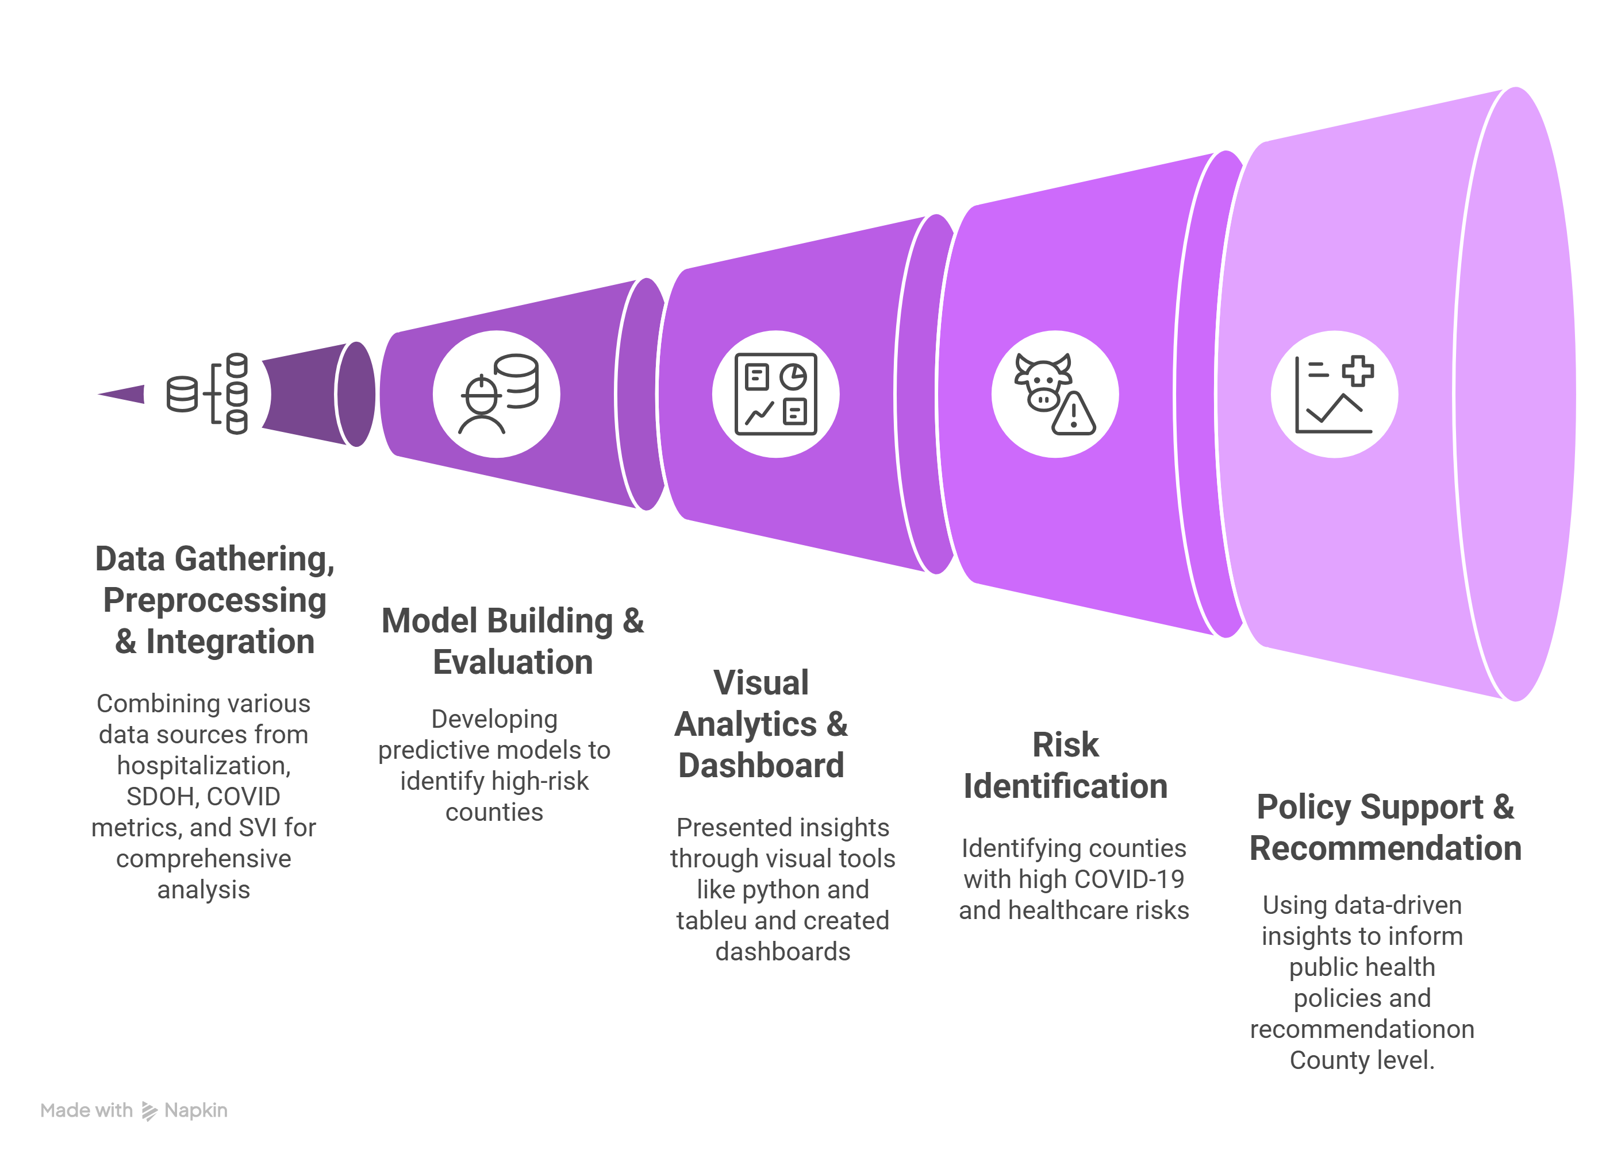
PROJECT OVERVIEW

Slide 3
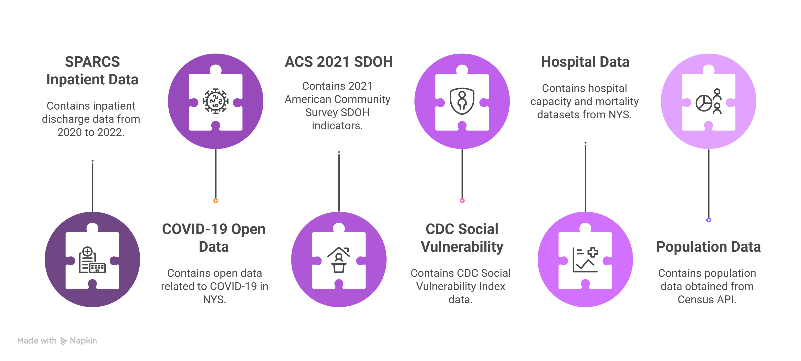
DATASET SOURCE

Slide 4
DATA PREPARATION & CLEANING :-
Filtered SPARCS hospitalization dataset (2020–2022)
- Focused on essential fields: Length of Stay, Charges, Age Group, etc.
Converted string-based numeric columns to proper numerical types
Standardized county names for consistency
Removed invalid or incomplete entries to ensure data quality
Aligned formatting across all datasets for reliable merging

Slide 5
Aggregation & External Data Integration :
SPARCS AGGREGATION
Grouped by county to calculate :
Average length of stay (Avg_LOS)
Total hospitalization
ACS, SDOH & COVID Testing Data
Extracted median income, education, and insurance coverage from ACS (2021)
Pulled COVID testing, fatalities and hospitalization data from NY Open Data.
Calculated COVID Positivity Rate:
(New Positives / Total Tests) * 100
Average Charges and Cost.

Slide 6
Vulnerability Metrics & Final Assembly
SVI & Public Health Burden Indicators
SVI & Public Health Burden Indicators:
Economic hardship, housing instability, minority status
Added hospitalization load: deaths, ICU capacity, staffed beds
DATASET MERGING
Unified all the datasets at the county level.
Final Output :
final_merged_county_level_covid_sdoh_svi.csv
enriched_county_level_dataset.csv

Slide 7
Feature Engineering:-
Hosp_per_100k: Hospitalizations scaled to population size.
Deaths_per_100k: COVID deaths per 100,000 residents.
Charges_to_Costs_Ratio: A proxy for pricing volatility.
Uninsured_Rate: Derived from total insurance coverage.
High_Risk: Binary label where 1 = counties with positivity rates greater than the median.

Slide 8
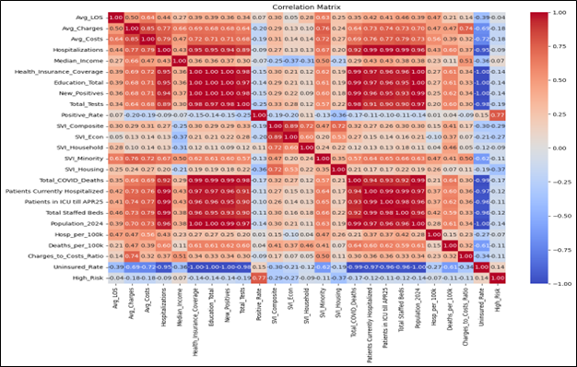
Exploratory Data Analysis & Visualizations
Correlation Heatmap: Strong correlation between income, hospitalization, and positivity
Scatterplot: SVI vs Positivity rate shows upward trend
Cost Distribution: High variance in avg charges

Slide 9
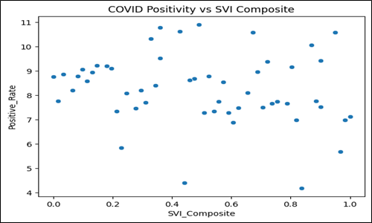
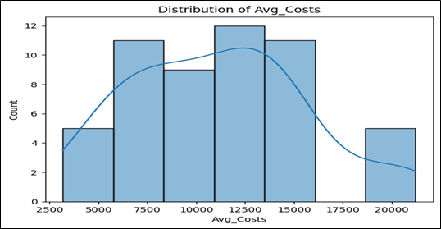
Note: neque digni and in aiquet nisl et a umis varius.

Slide 10
MODELLING APPROACH
Target Variable: High_risk (Binary classification)
Feature Chosen :
Avg_LOS, Avg_ Charges, Avg_Cost, Hosp_per_100k
Uninsured_rate, Median_income, SVI_Composite,SVI_Econ,_SVI-Minority
TRAINED Models :
Logistic Regression
K-Nearest Neighbours (K=5)
XGBoost Classifier

Slide 11
MODEL COMPARISION
Metric | Logistic Regression | KNN (k=5) | XGBoost Classifier
Accuracy | 52.9% | 47.1% | 58.8%
Precision | 75.0% | 57.1% | 71.4%
Recall | 30.0% | 40.0% | 50.0%
F1 Score | 0.429 | 0.472 | 0.588
ROC AUC | 0.471 | 0.550 | 0.671
Remarks | High precision but poor recall—misses many high-risk cases | Unstable; likely overfitting or poor scaling | Best overall balance; good baseline for improvement

Slide 12
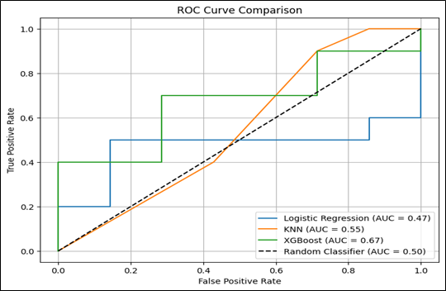
ROC CURVE ANALYSIS
The XGBoost model outperformed others by a wide margin, as evident from the ROC plot, where its curve is close to the top-left corner and has the highest AUC.
This verifies its excellence in separating high-risk counties.

Slide 13
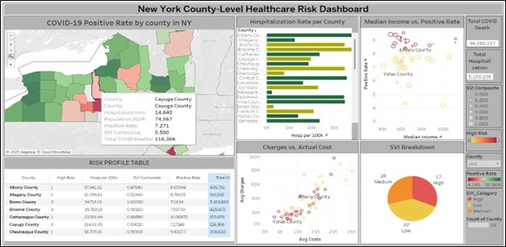
DASHBOARD : STORYTELLING

Slide 14
INSIGHTS FROM DASHBOARD:
Positivity Rate Map
by County:
Darker red = higher COVID transmission
Tooltip displays: SVI score, hospitalization, total deaths
County Risk Table:
High-risk label (based on positivity threshold)
Hospitalization rate per 100k
SVI Composite and COVID-19 deaths
Highlights high-burden counties like Albany and Broome

Slide 15
INSIGHTS FROM DASHBOARD :
Scatterplot 1 – Median Income vs. Positivity:
Shows inverse trend: lower income often links to higher positivity
Suggests socioeconomic exposure risk
Scatterplot 2 – Avg Charges vs. Cost:
Positive trend with outliers
Reveals variability in hospital pricing practices across counties
Pie Chart – Social Vulnerability Index (SVI):
~50% of counties fall under medium/high vulnerability
Indicates widespread structural risk acro regions

Slide 16
KEY OUTCOMES & INSIGHTS:-
📊 Structural Inequity Drives Risk
Higher COVID-19 positivity is linked to:
Lower median income
Higher uninsured rates
Elevated Social Vulnerability Index (SVI)
Indicates strong association between social determinants and public health outcomes
🧠 Predictive Modeling as a Tool
XGBoost outperformed other models in identifying high-risk counties
Useful for guiding targeted interventions such as:
Mobile testing units
Vaccine and health outreach programs
Next Step: Feature Importance Analysis
Proposed for deeper model interpretation
Can reveal which SDOH variables most influence COVID transmission
Supports evidence-based policymaking and resource prioritization

Slide 17
Future Implications & Recommendations
1. Feature Expansion
Integrate additional dynamic variables for better accuracy:
Vaccination rates
Mask adherence data
Mobility patterns
2. Temporal Modeling
Develop a time-series forecasting model to anticipate:
COVID-19 case surges
Hospital resource demands
3. Equity-Driven Resource Allocation
Leverage model predictions to direct:
Funding and testing
Vaccine access to socially underserved counties
4. Real-World Model Deployment
Fine-tune and validate XGBoost for use in
Interactive public health dashboards
Policy-making tools for real-time action

Slide 18
THANK YOU!

